Slide 1
Supplier qualification
Instructions for Ariba SLP

Slide 2
Qualification in the Ariba network
After you have successfully registered with TTS Tooltechnic Systems, you can receive an invitation for supplier qualification. This invitation is started by the responsible purchaser.
Data on certificates and information on the product category or your products are requested here. With this information the purchaser can check if a cooperation should be started.

Slide 3
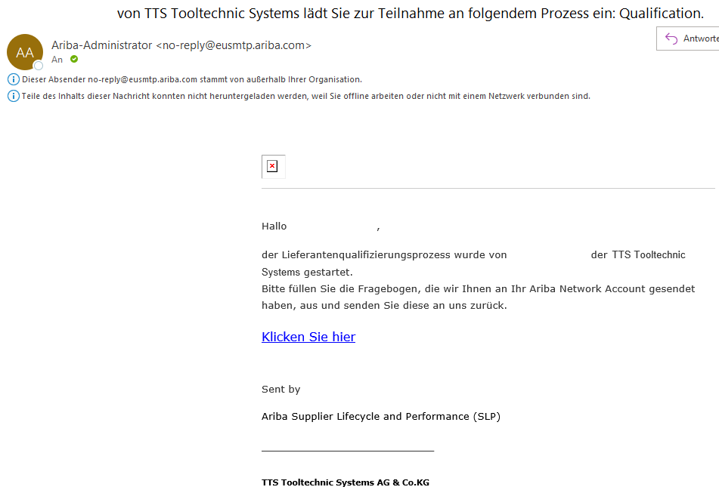
Invitation to the qualification
To accept the invitation to participate in the qualification process from TTS Tooltechnic Systems, please follow the link in the email with the subject ".. from TTS Tooltechnic Systems invites you to participate in the following process: Qualification".

Slide 4
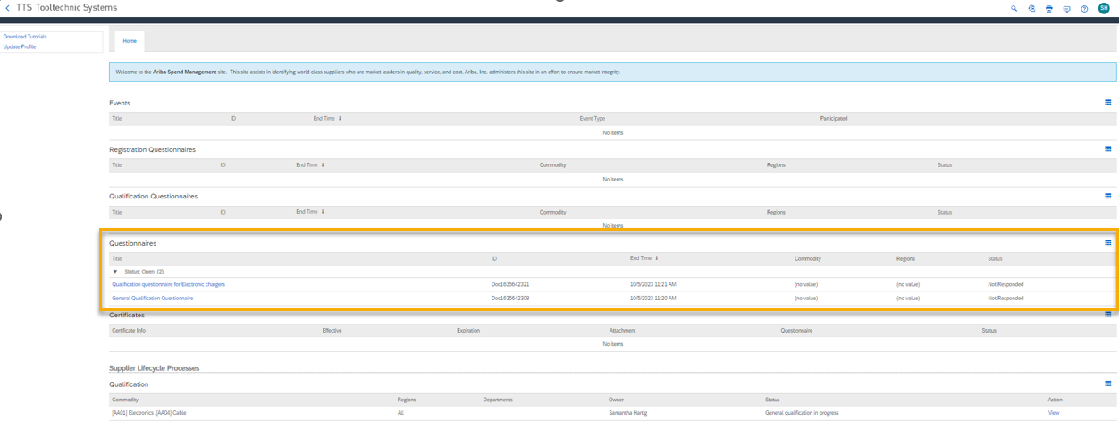
Ariba SLP View
After logging in to Ariba SLP, you will see the received questionnaires for qualification in the Questionnaires area.
There are always at least 2 questionnaires sent for qualification:
Questionnaire: General qualification questionnaire
Questionnaire: Specific product category questionnaire
→ Depending on how many product categories have been specified by you in the registration, several specific product category questionnaires may be provided.

Slide 5
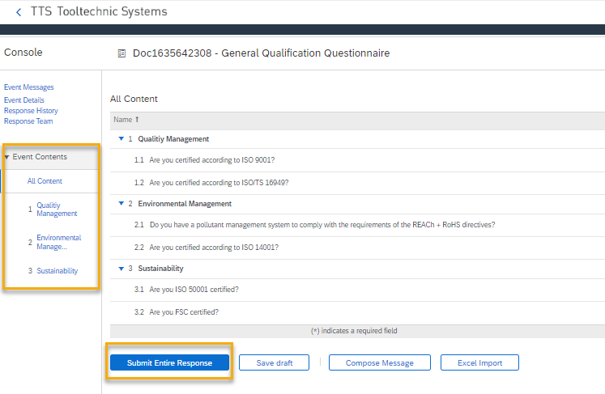
Questionnaire: General qualification questionnaire
Open the general qualification questionnaire. Several certificates are checked here, which you can directly deposit as an attachment.

Slide 6
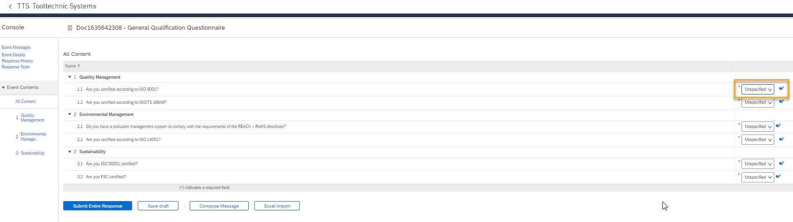
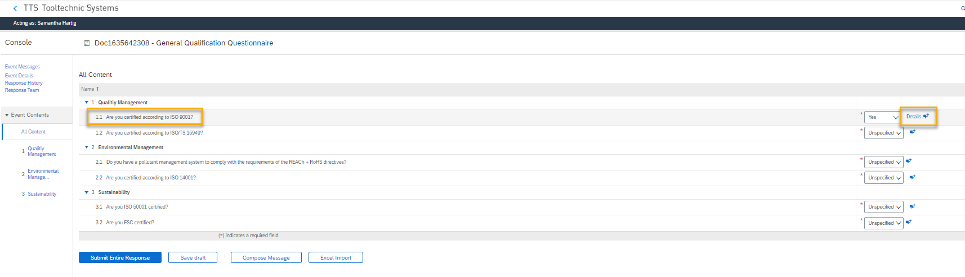
Information: General qualification questionnaire
Please note the possibility that the certificate can be deposited in the attachment.
As soon as you select "Yes" for the question, "Details" will appear behind it. Click on "Details" to store the certificates as an attachment.

Slide 7
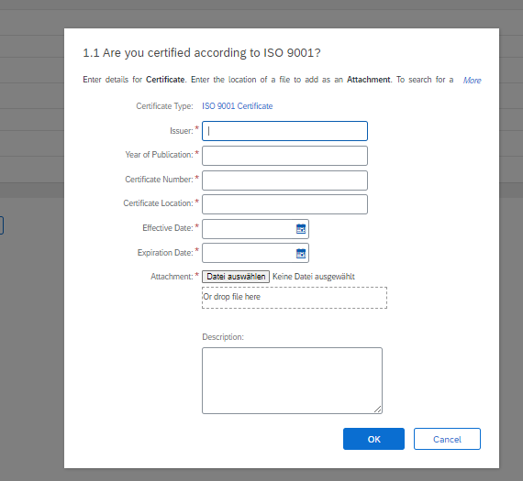
Information: General qualification questionnaire
As soon as you have clicked on "Details", a window will open. Here you can enter further details about the certificate and upload the certificate.
Confirm these details and the attachment with "OK" afterwards.

Slide 8
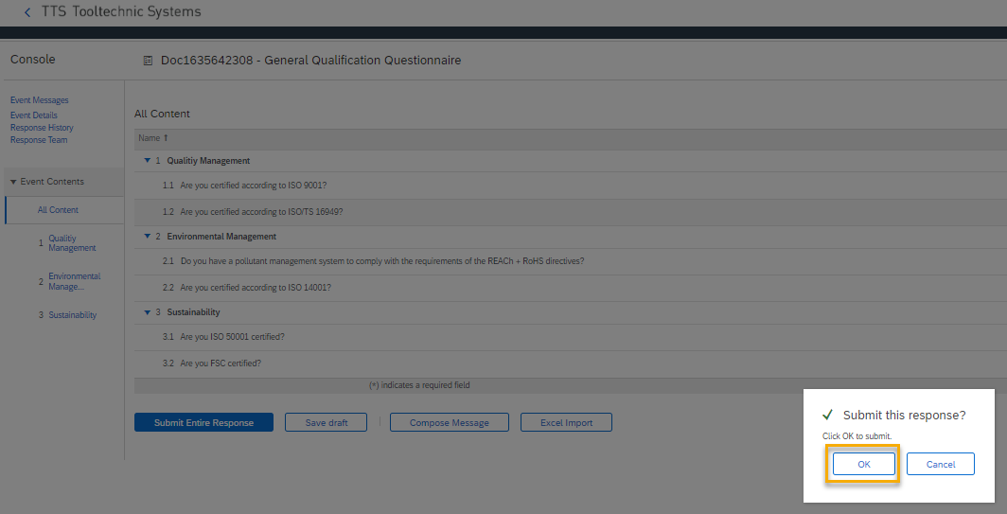
Questionnaire: General qualification questionnaire
After you have answered all sections of the questionnaire, you can save it as a draft and edit it later.
If the questionnaire has been completed in full, you can return the answers to us via "Submit entire response".

Slide 9
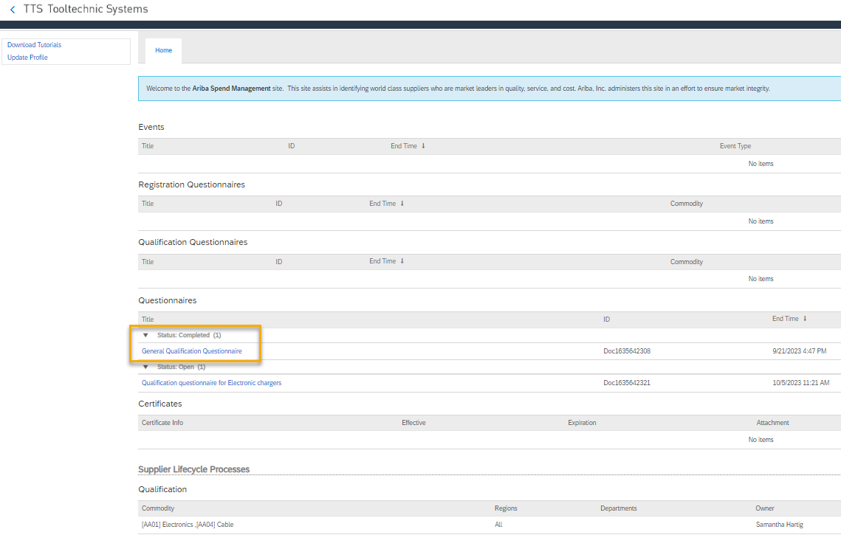
Qualification questionnaires
After you have submitted a questionnaire, so you sent it back to TTS Tooltechnic Systems, the questionnaire is displayed with the status "Completed".

Slide 10
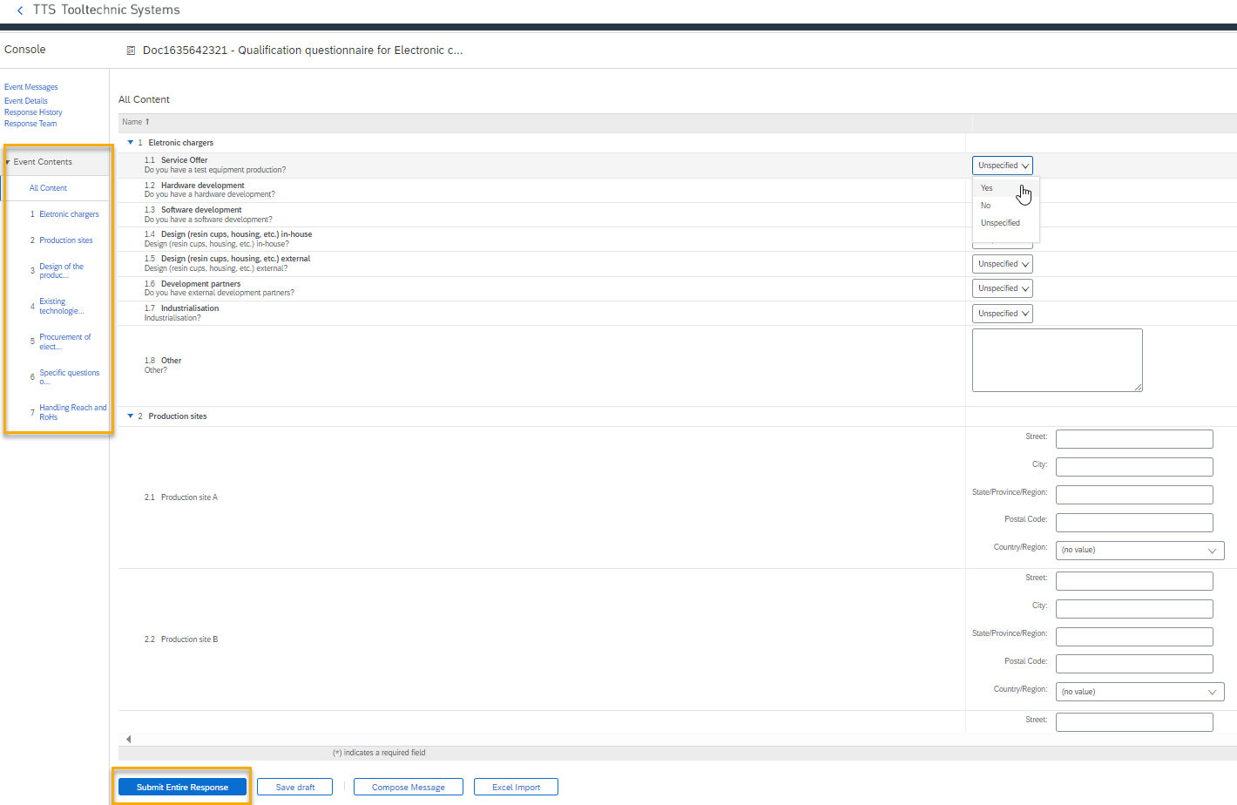
Questionnaire: Specific product category questionnaire
Open the specific product category questionnaire. Here you will be asked several questions about the specified product category.
After you have answered all sections of the questionnaire, you can save it as a draft and edit it further later.
If the questionnaire has been completed in full, you can return the answers to us via "Submit entire response".

Slide 11
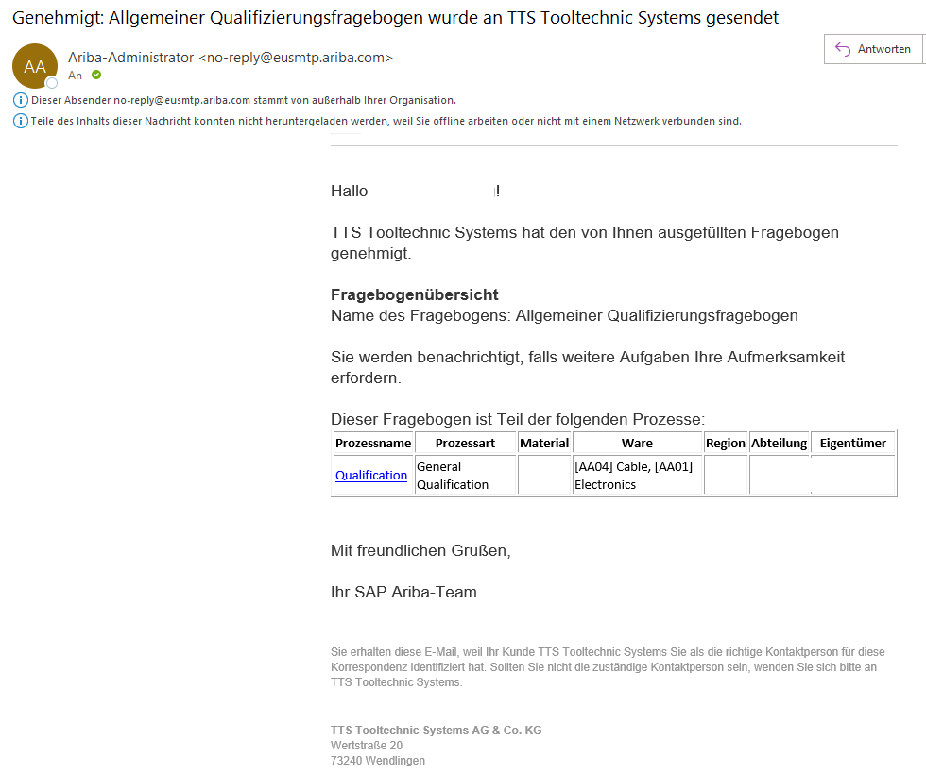
Approval of the questionnaires for qualification
After you submit the completed questionnaires for qualification, the responsible purchaser can check the data.
If the questionnaire: General Qualification Questionnaire is approved by TTS Tooltechnic Systems you will receive the e-mail with the subject "Approved: General Qualification Questionnaire has been sent to TTS Tooltechnic Systems".
If you click on the "Qualification" link in the email, you will enter the questionnaire to view your answers again.

Slide 12
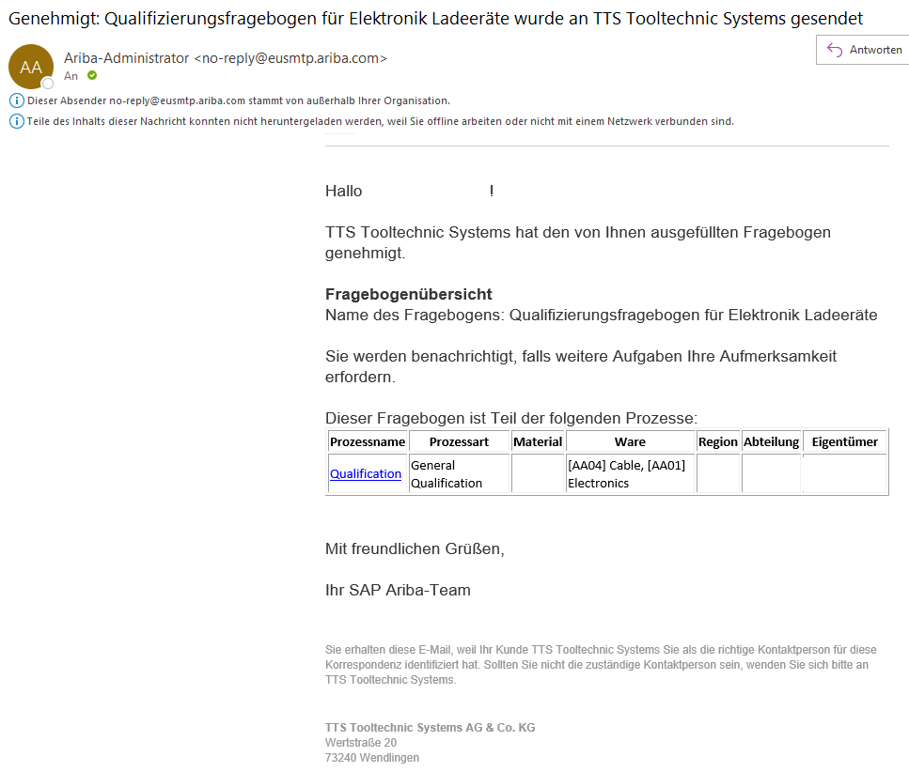
Approval of the questionnaires for qualification
After you submit the completed questionnaires for qualification, the responsible purchaser can check the data.
If the Questionnaire: Specific Product Category Questionnaire is approved by TTS Tooltechnic Systems you will receive the e-mail with the subject "Approved: Qualification Questionnaire for … has been sent to TTS Tooltechnic Systems".
Clicking the "Qualification" link in the email will take you to the questionnaire to view your answers again.

Slide 13
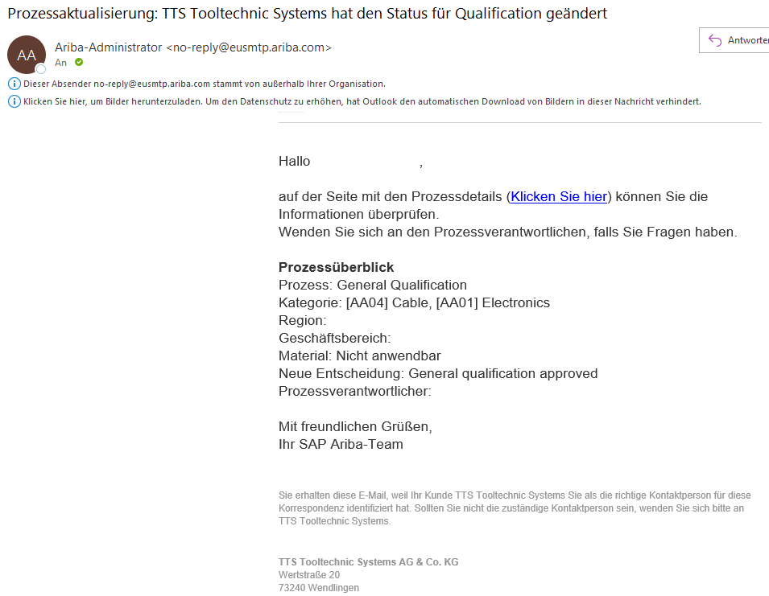
Status: Qualified
Your supplier status will now be changed to "qualified" in our system. You will receive an e-mail about this with the subject "Process update: TTS Tooltechnic Systems has changed status for Qualification". From this point on, we will be able to consider you in future requests.

Slide 14
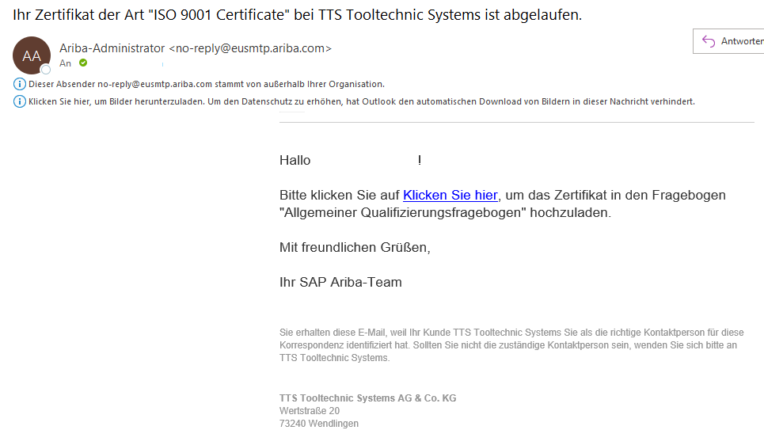
Certificate expired
As soon as a certificate has expired, you and the responsible purchaser will receive an e-mail with the subject "Your certificate of type ... at TTS Tooltechnic Systems has expired".
By clicking on "Click here" you can jump directly to the questionnaire with the corresponding certificate and update it.

