Slide 1
Supplier registration
Instructions for Ariba SLP

Slide 2
Variants for registration in the Ariba network
Variant 1:
If you would like to register as a supplier with TTS Tooltechnic Systems on your own initiative, please refer to slides 3-8.
Variant 2:
If you have received an e-mail with an invitation to register, please refer to slides 9-13. If you already have an account with Ariba Network, log in there with your access data. If you do not yet have an account with Ariba Network, please proceed according to slide 3.

Slide 3
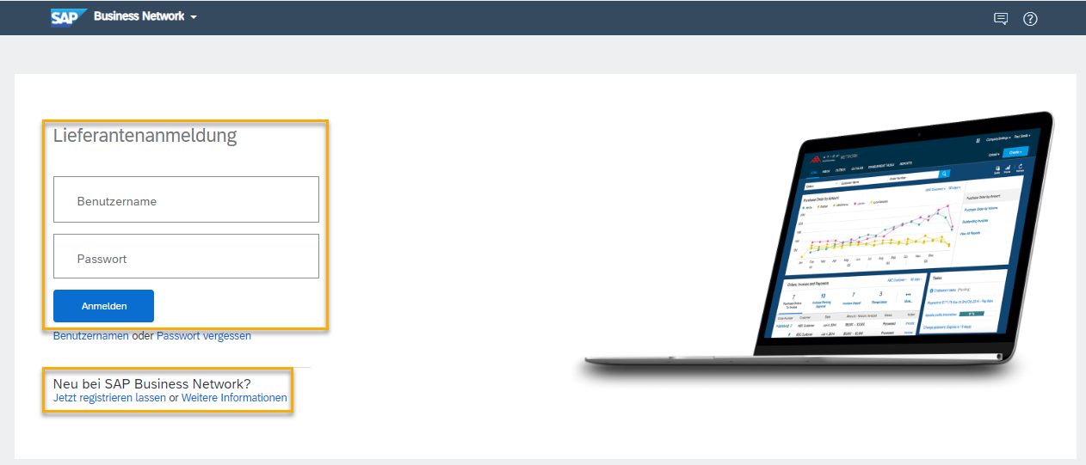
Variant 1: Supplier Request
Self-Registration Supplier
If you would like to register on your own initiative as a supplier to TTS Tooltechnic Systems, please refer to slides 4-6.
To start the registration process, please open the following account creation link: SAP Business Network Supplier (ariba.com)
To start directly with the registration, please open the following link if you already have an account with SAP Ariba: Ariba Spend Management

Slide 4
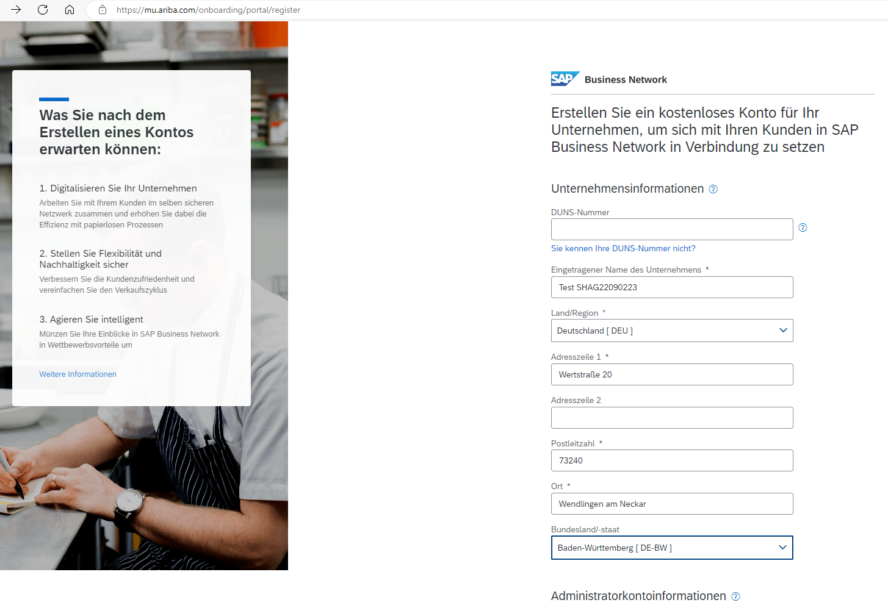
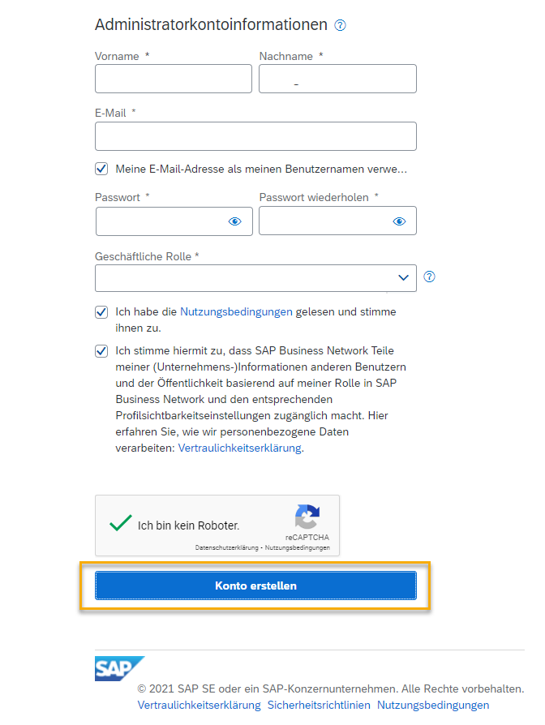
Variant 1: Supplier Request
Create SAP Ariba account
After you click the "Register Now" link, you can create a business account for free.

Slide 5

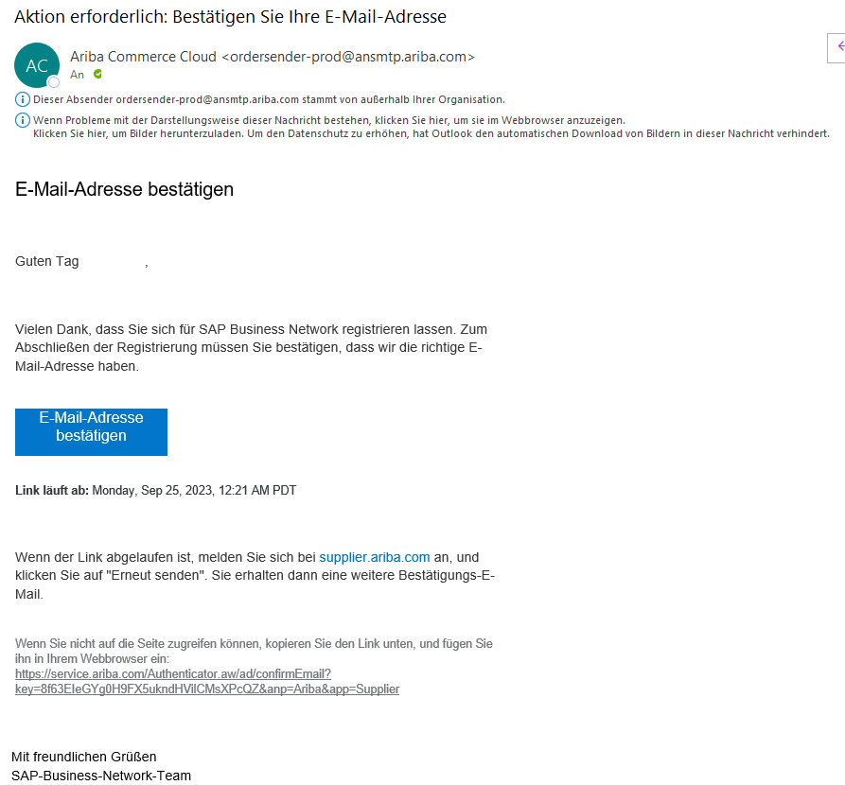
Variant 1: Supplier Request
Create SAP Ariba account
Afterwards, the specified e-mail must be confirmed. You will receive an e-mail with the subject "Action required: Confirm your e-mail address".
Now click on "Confirm e-mail address".

Slide 6
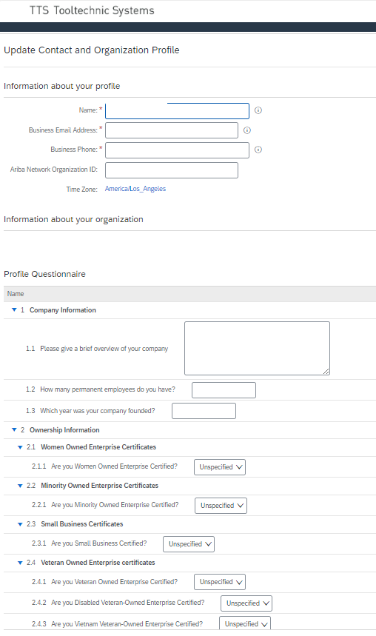

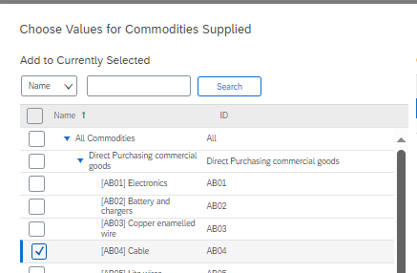
Variant 1: Supplier Request
Create SAP Ariba account
Now complete your company profile with the questions from TTS Tooltechnic Systems.
Required fields are marked with *.
The questionnaire will be sent to TTS Tooltechnic Systems via "OK".

Slide 7
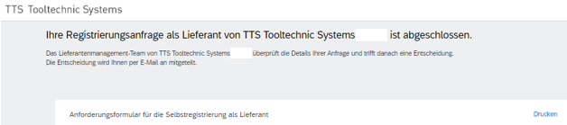
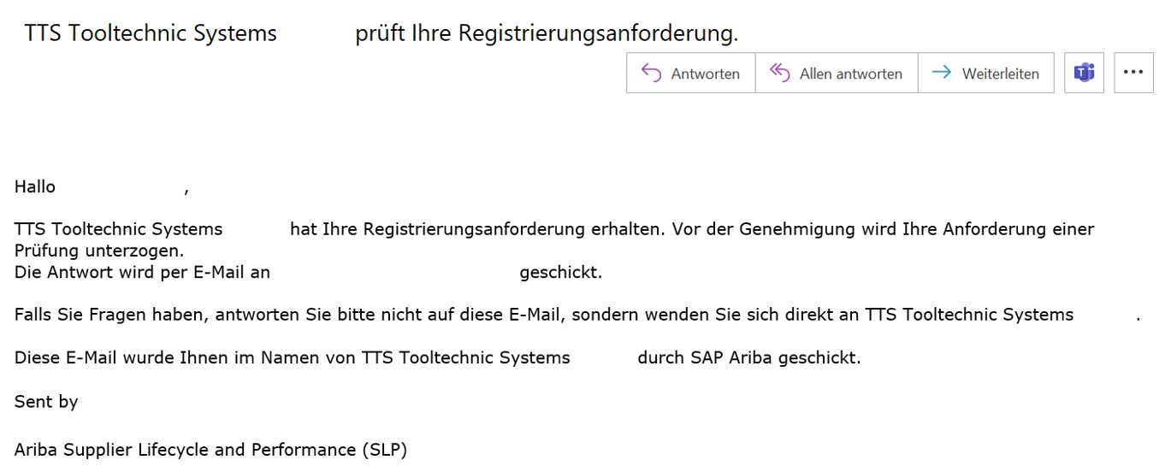
Registration request form sent
After submitting your registration request, you will receive the e-mail “Your registration request as a supplier of TTS is completed”.
Below the message, you can view your maintained data and, if required, download it for your records via the "Print" function.
In addition, you will receive a confirmation by e-mail.

Slide 8
Next steps
The first step is now done - we have received your company profile.
Purchasing staff will then review your registration request and, if required and interested, the full registration form will be emailed to you (please refer to slides 11-13 for processing). Upon return of the completed registration form, it will be approved. Only then is your registration complete and you will receive the status "Registered" in our system. Only then can our purchasing staff consider you in future qualification processes and requests.
Please refrain from requests with us in the meantime, we will contact you in case of need and interest.

Slide 9
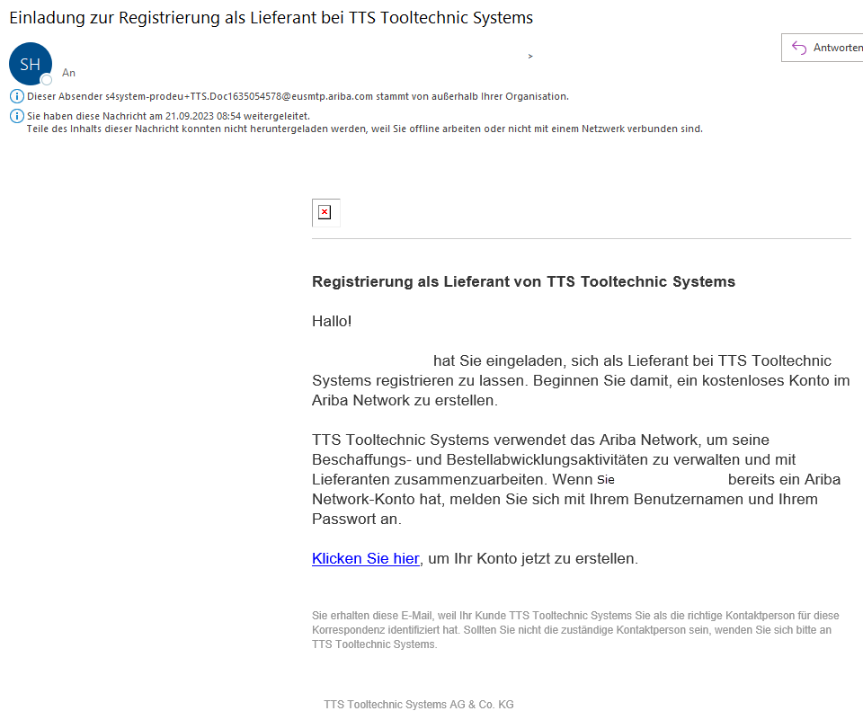
Variant 2: Invitation to supplier registration
To accept the invitation to register from TTS Tooltechnic Systems, please follow the link in the email with the subject "Invitation to register".

Slide 10
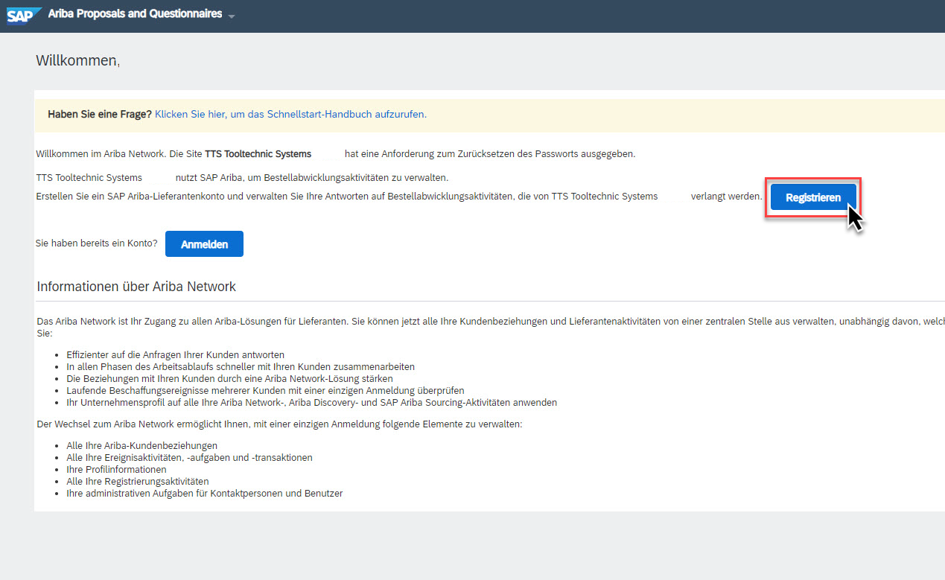
Login to the Ariba Network
If you do not have an account with Ariba Network yet, please click on "Register". Please refer to slides 4-6.
If you already have an Ariba account, follow the "Sign in" button. After logging in, please follow the slides below.

Slide 11
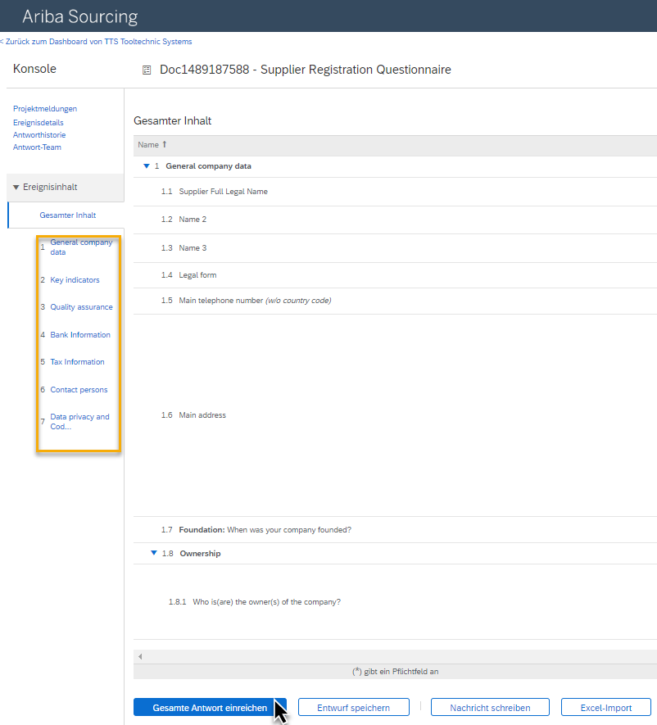
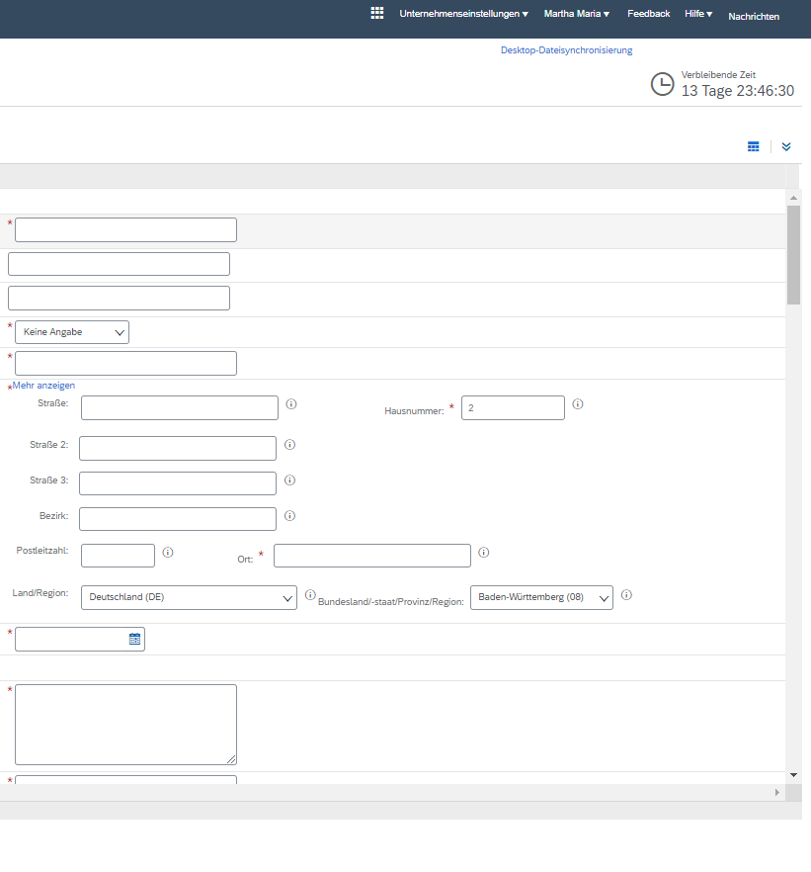
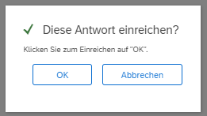
Fill out registration questionnaire
After you have created the account, you will be taken directly to our TTS Tooltechnic Systems specific registration questionnaire.
Please fill in the individual sections and follow the instructions provided. Afterwards, send the questionnaire back to us via "Submit complete answer".
You can save the current status at any time, export it and add to it later.

Slide 12
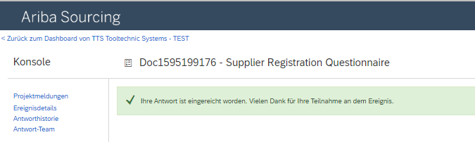
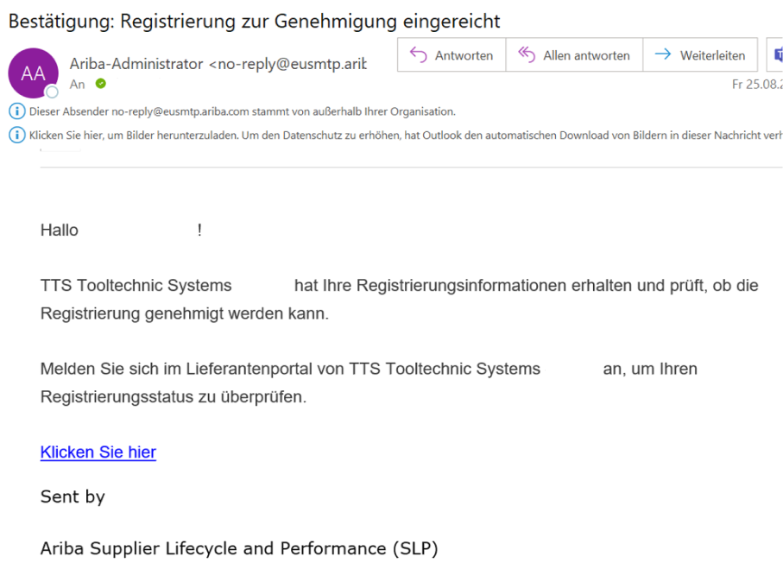
Send registration questionnaire
After you submit the questionnaire, you will receive confirmation of submission on the Ariba Business Network and via e-mail.

Slide 13
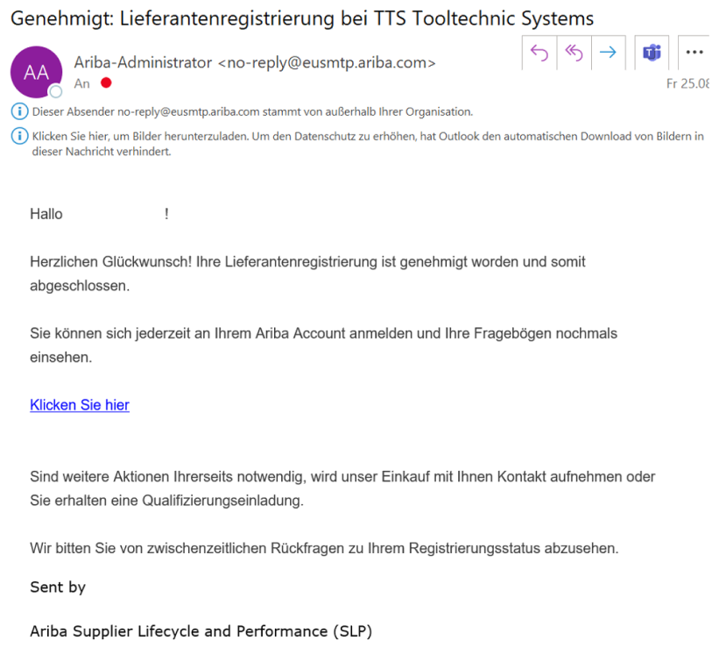
Registration confirmation
After the responsible purchasing staff confirms your registration, you will receive a notification by e-mail.
Your status in our system is "registered". From this point on, our purchasing staff can consider you in future qualification processes and requests.

